Slide 1
Introduction: Convolutional Neural Networks for Visual Recognition

Slide 2
Introduction to Deep Learning TensorFlow, Keras and Convolutional Neural Networks (CNN) for Visual Recognition

Slide 3
Buzz…

Slide 4
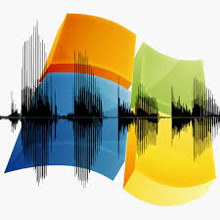
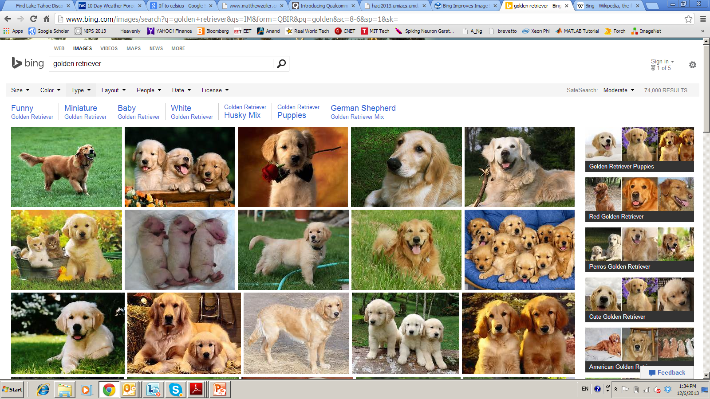


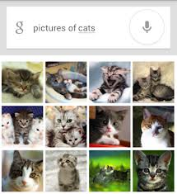

Deep Learning – from Research to Technology
Deep Learning - breakthrough in visual and speech recognition

Slide 5
TensorFlow
TensorFlow is an end-to-end open source platform for machine learning by Google.
TensorFlow, as the name indicates, is a framework to define and run computations involving tensors.
It has a comprehensive, flexible ecosystem of tools, libraries and community resources to easily build and deploy ML powered applications.
TensorFlow makes it easy for beginners and experts to create machine learning models for desktop, mobile, web, and cloud.

Slide 6
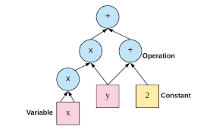
TensorFlow
f(x,y)=x²y+y+2
Define your computation as python graph
TensorFlow will runs it efficiantly using optimized C++ Code
Graph can be divided into number of chunks and run them in parallel across multiple CPUs and GPUs

Slide 7
Creating First Graph and Running
Import tensorflow as tf
x=tf.Variable(3,name=‘x’)
y=tf.Variable(4,name=‘y’)
f=x*x*y+y+2
init=tf.global_variable_initializer()
with tf.Session() as sess:
init.run() #initialize all variables
Result=f.eval()
print(Result)

Slide 8
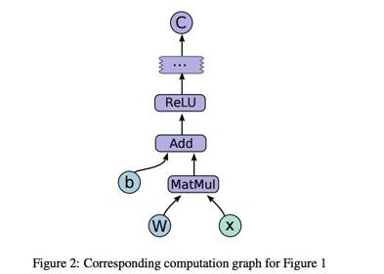
Perceptron inTensorFlow

Slide 9
Perceptron inTensorFlow
# define two matrices
matrix1 = tf.constant([[3., 3.]])
matrix2 = tf.constant([[2.],[2.]])
# do multiplication
product = tf.matmul(matrix1, matrix2)
# Let’s get a new session
sess = tf.Session()
# launch a session, indicate “product” is what we want to get
result = sess.run(product)
print(result)
# the output is : [[ 12.]]
sess.close()

Slide 10
Keras
Keras is our recommended library for deep learning in Python, especially for beginners. Its minimalistic, modular approach makes it a breeze to get deep neural networks up and running.

Slide 11
Deep Neural Network
Deep learning refers to neural networks with multiple hidden layers that can learn increasingly abstract representations of the input data. This is obviously an oversimplification, but it’s a practical definition for us right now.
For example, deep learning has led to major advances in computer vision. We’re now able to classify images, find objects in them, and even label them with captions. To do so, deep neural networks with many hidden layers can sequentially learn more complex features from the raw input image:
The first hidden layers might only learn local edge patterns.
Then, each subsequent layer (or filter) learns more complex representations.
Finally, the last layer can classify the image as a cat or kangaroo.
These types of deep neural networks are called Convolutional Neural Networks.

Slide 12
Convolutional Neural Networks (CNN’s)
In a nutshell, Convolutional Neural Networks (CNN’s) are multi-layer neural networks (sometimes up to 17 or more layers) that assume the input data to be images.

Slide 13
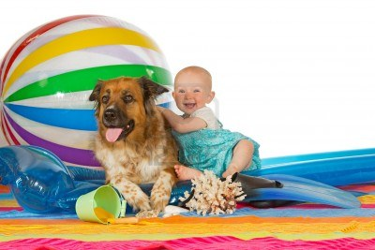
Classical Computer Vision Pipeline

Slide 14
Classical Computer Vision Pipeline.
CV experts
Select / develop features: SURF, HoG, SIFT, RIFT,..
Add on top of this Machine Learning for multi-class recognition and train classifier
Feature
Extraction:
SIFT, HoG...
Detection,
Classification
Recognition
Classical CV feature definition is domain-specific and time-consuming

Slide 15
Deep Learning –based Vision Pipeline.
Deep Learning:
Build features automatically based on training data
Combine feature extraction and classification
DL experts: define NN topology and train NN
Deep NN...
Deep NN...
Detection,
Classification
Recognition
Deep Learning promise:
train good feature automatically,
same method for different domain

Slide 16
Computer Vision +Deep Learning + Machine Learning
We want to combine Deep Learning + CV + ML
Combine pre-defined features with learned features;
Use best ML methods for multi-class recognition
CV+DL+ML experts needed to build the best-in-class
CV
features
HoG, SIFT
Deep
NN...
ML
AdaBoost
…
Combine best of Computer Vision
Deep Learning and Machine Learning

Slide 17
Deep Learning Basics
Deep Learning – is a set of machine learning algorithms based on multi-layer networks
CAT
DOG
OUTPUTS
HIDDEN
NODES
INPUTS

Slide 18
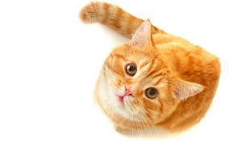
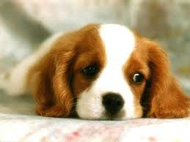
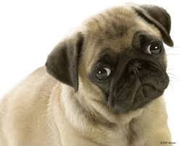
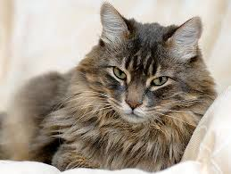
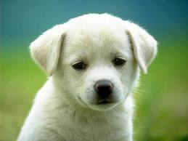

Deep Learning Basics
Deep Learning – is a set of machine learning algorithms based on multi-layer networks
CAT
DOG
Training

Slide 19
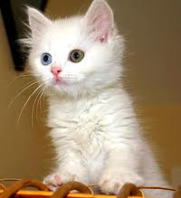
Deep Learning Basics
Deep Learning – is a set of machine learning algorithms based on multi-layer networks
CAT
DOG

Slide 20
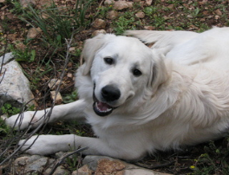
Deep Learning Basics
Deep Learning – is a set of machine learning algorithms based on multi-layer networks
CAT
DOG

Slide 21
Deep Learning Taxonomy
Supervised:
Convolutional NN ( LeCun)
Recurrent Neural nets (Schmidhuber )
Unsupervised
Deep Belief Nets / Stacked RBMs (Hinton)
Stacked denoising autoencoders (Bengio)
Sparse AutoEncoders ( LeCun, A. Ng, )

Slide 22
Convolutional Networks

Slide 23
Convolutional NN
Convolutional Neural Networks is extension of traditional Multi-layer Perceptron that are extremely effective at dealing with image data, based on 3 ideas:
Local receive fields
Shared weights
Spatial / temporal sub-sampling

Slide 24
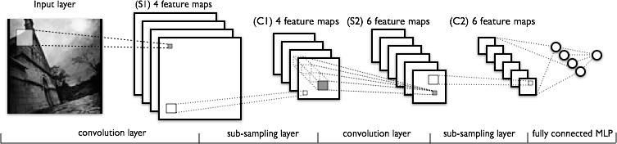
What is Convolutional NN ?
CNN - multi-layer NN architecture
Convolutional + Non-Linear Layer
Sub-sampling Layer
Convolutional +Non-L inear Layer
Fully connected layers
Supervised
Feature Extraction
Classi-
fication

Slide 25

What is Convolutional NN ?
2x2
Convolution + NL
Sub-sampling
Convolution + NL

Slide 26
What is Convolution?
Convolution is using a ‘kernel’ to extract certain ‘features’ from an input image.
A convolution is how the input is modified by a filter.
In convolutional networks, multiple filters are taken to slice through the image and map them one by one and learn different portions of an input image.
Convolution filtering is used to modify the spatial frequency characteristics of an image.

Slide 27
Image kernel and Filters
A kernel is a matrix of weights which are multiplied with the input to extract relevant features.
Differently sized kernels containing different patterns of numbers produce different results under convolution.
The size of a kernel is arbitrary but 3x3 is often used
In image processing, there are a set few filters that are used to perform a few tasks like blur, sharpen, edge detection, Horizontal, vertical etc

Slide 28
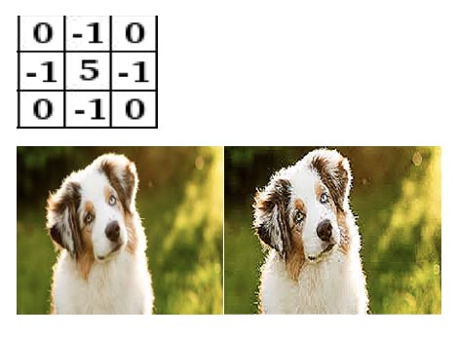
Filter to sharpen image
High pass filter returns all higher frequencies (max at center)

Slide 29
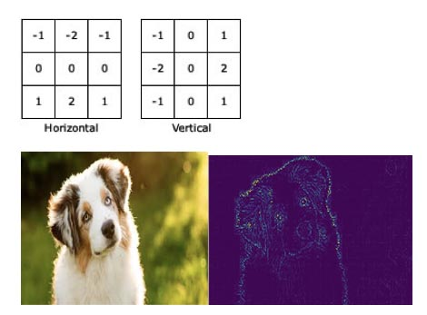
Filter

Slide 30
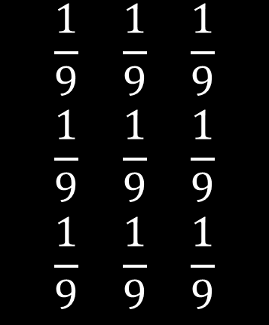
Low Pass Filter
$$\begin{matrix}\frac{1}{9} & \frac{1}{9} & \frac{1}{9} \\ \frac{1}{9} & \frac{1}{9} & \frac{1}{9} \\ \frac{1}{9} & \frac{1}{9} & \frac{1}{9}\end{matrix}$$
Low pass filter returns all lower frequencies (can be used to blur )

Slide 31
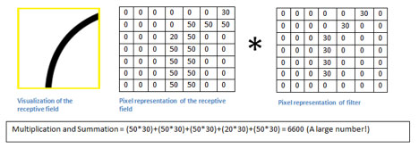
Why Filter
The matrix corresponds to a pattern or feature that the filter is looking for.
In the image below, the filter is looking for a curved line.
Whenever the filter comes across a pattern like that in the image, it gives a high output.

Slide 32
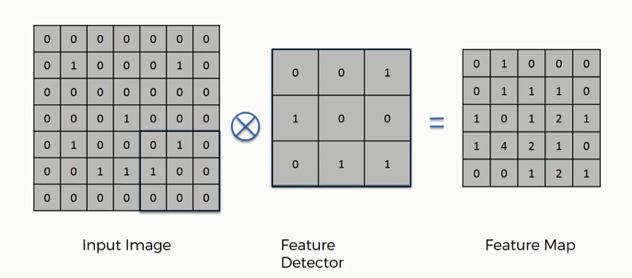
Filter as Feature Detector

Slide 33
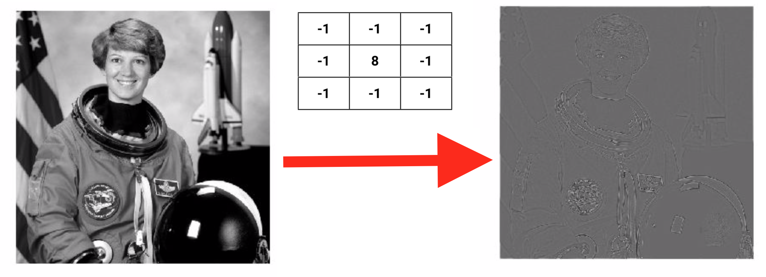
What is Convolution?
In figure convolution to detect dark edges

Slide 34
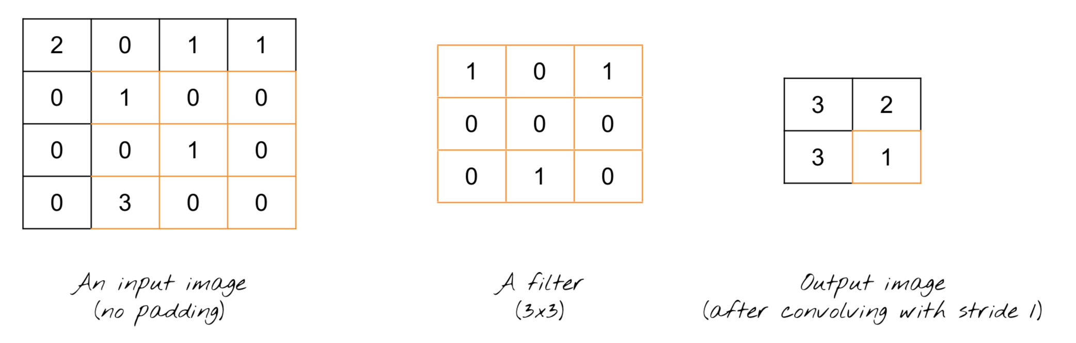
2D Convolution
Mathematically, it’s (2 * 1) + (0 * 0) + (1 * 1) + (0 * 0) + (1 * 0) + (0 * 0) + (0 * 0) + (0 * 1) + (1 * 0) = 3
here moved the filter by only one column. The step size as the filter slides across the image is called a stride

Slide 35
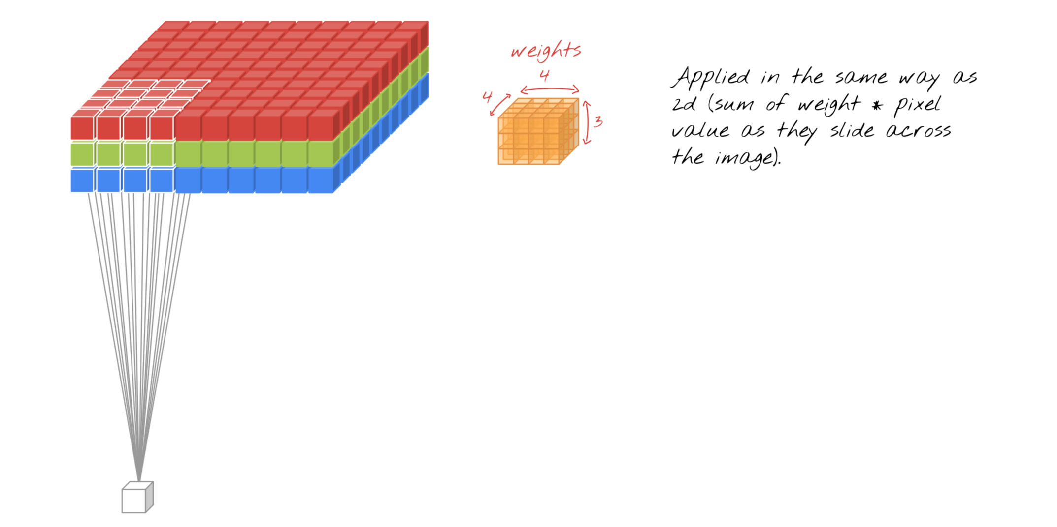
3D Convolution?
Convolution in 3D is just like 2D, except you are doing the 2d work 3 times, because there are 3 color channels.

Slide 36
Padding
2D Convolution
The size of the output image is smaller than that of the input image (most cases)
3D Convolution
The width of the output gets smaller, just like the size of the output in 2D case
If you want to keep the output image at the same width and height without decreasing the filter size, you can add padding to the original image with zero’s and make a convolution slice through the image.

Slide 37
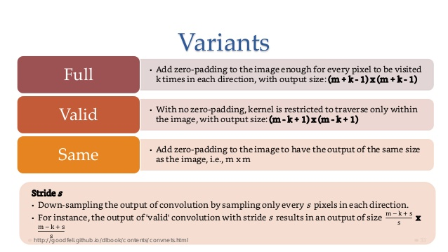
Padding

Slide 38
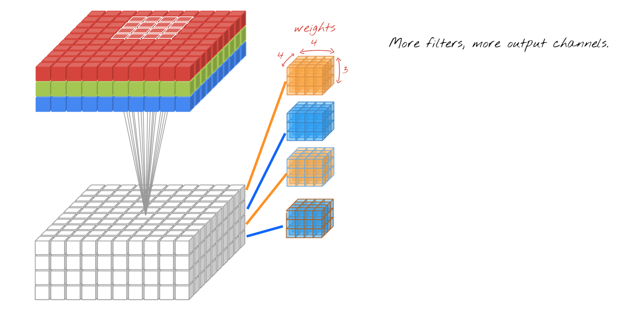
More filter
Add more filters to increases the depth of the output image. Each layer corresponds to one filter and learns one set of weights.

Slide 39
Pooling/Subsampling
Separate step from convolution.
A pooling or subsampling layer often immediately follows a convolution layer in CNN
Its role is to downsample the output of a convolution layer along both the spatial dimensions of height and width
Used to reduce the image size of width(x) and height(y).

Slide 40
Pooling/Subsampling
Generally picks the maximum value in a certain size of the window.
The primary function of a pooling later is to reduce the number of parameters to be learned by the network.
additional effect of reducing overfitting and thereby increasing the overall performance and accuracy of the network

Slide 41
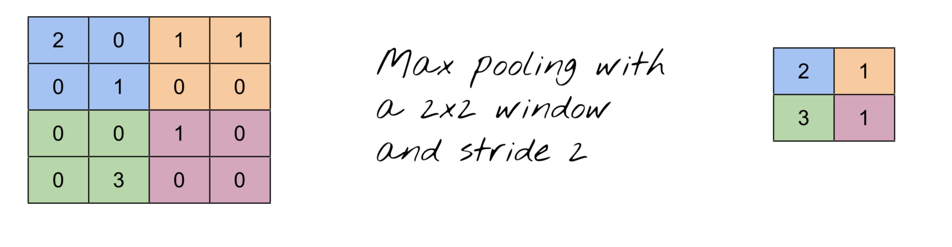
Max Pooling

Slide 42
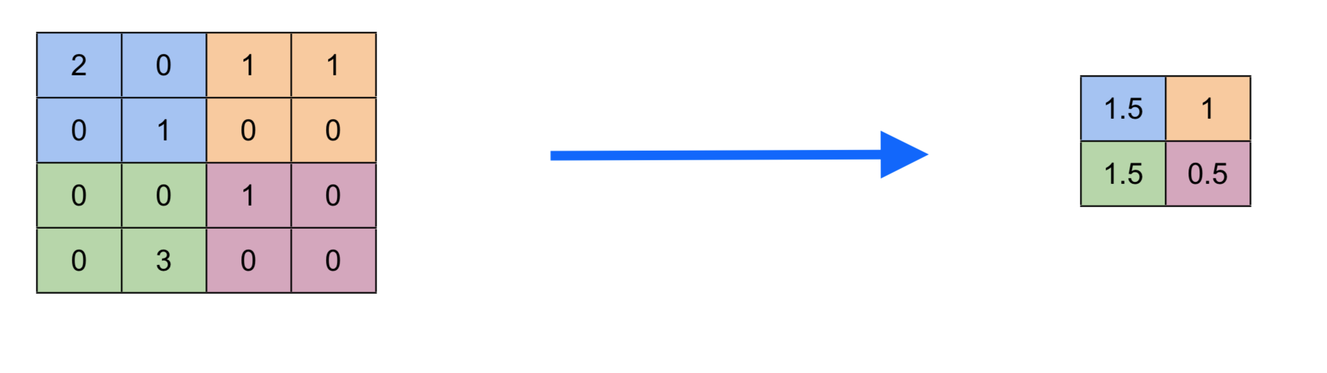
Average Pooling

Slide 43
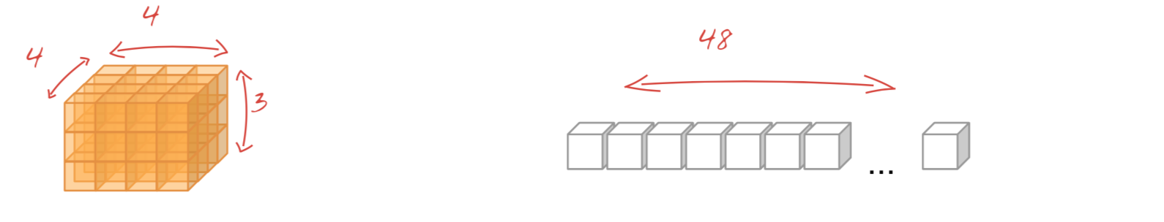
Flatten
It unstacks the volume above it into an array.

Slide 44
Dense Layer
A dense layer is just a regular layer of neurons in a neural network.
Each neuron receives input from all the neurons in the previous layer, thus densely connected.

Slide 45
CNN Architecture
Most successful architecture uses
one or more stacks of convolution + pool layers with relu activation,
followed by a flatten layer then
one or two dense layers

Slide 46
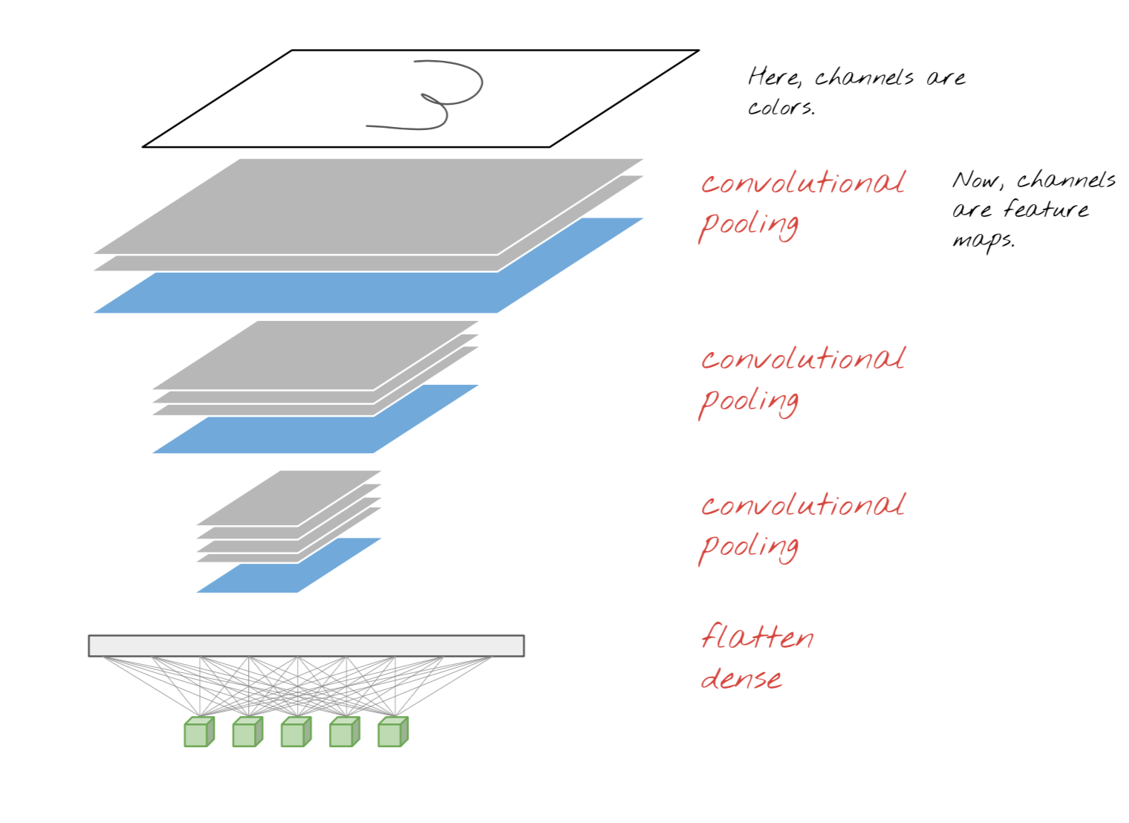
CNN Architecture

Slide 47
Working CNN
In each Conv Layer the network tries to understand the basic patterns.
For example:
In the First layer, the network tries to learn patterns and edges.
In the second layer, it tries to understand the shape/ color and other stuff.
A final layer called Feature layer/Fully Connected layer tries to classify the image.

Slide 48
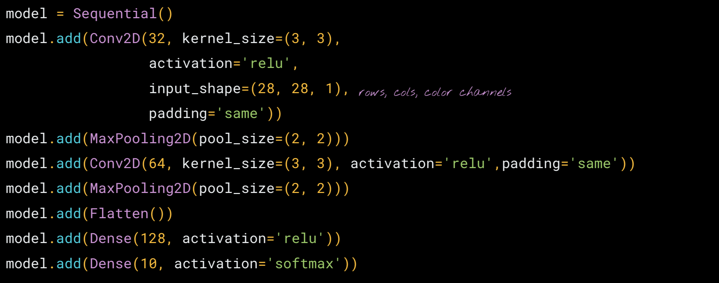
CNN netowrk in Keras

Slide 49
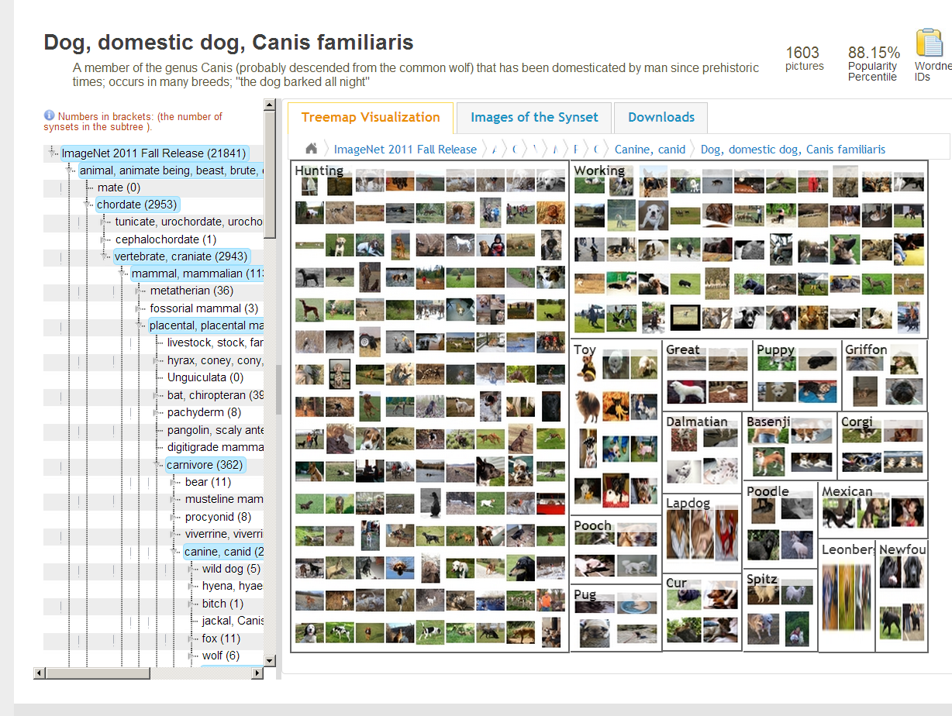
CNN success story: ILSVRC 2012
Imagenet data base: 14 mln labeled images, 20K categories

Slide 50
ILSVRC: Classification

Slide 51
Imagenet Classifications 2012

Slide 52
ILSVRC 2012: top rankers
http://www.image-net.org/challenges/LSVRC/2012/results.html
N | Error-5 | Algorithm | Team | Authors
1 | 0.153 | Deep Conv. Neural Network | Univ. of Toronto | Krizhevsky et al
2 | 0.262 | Features + Fisher Vectors + Linear classifier | ISI | Gunji et al
3 | 0.270 | Features + FV + SVM | OXFORD_VGG | Simonyan et al
4 | 0.271 | SIFT + FV + PQ + SVM | XRCE/INRIA | Perronin et al
5 | 0.300 | Color desc. + SVM | Univ. of Amsterdam | van de Sande et al

Slide 53
Imagenet 2013: top rankers
http://www.image-net.org/challenges/LSVRC/2013/results.php
N | Error-5 | Algorithm | Team | Authors
1 | 0.117 | Deep Convolutional Neural Network | Clarifi | Zeiler
2 | 0.129 | Deep Convolutional Neural Networks | Nat.Univ Singapore | Min LIN
3 | 0.135 | Deep Convolutional Neural Networks | NYU | Zeiler Fergus
4 | 0.135 | Deep Convolutional Neural Networks |  | Andrew Howard
5 | 0.137 | Deep Convolutional Neural Networks | Overfeat NYU | Pierre Sermanet et al

Slide 54
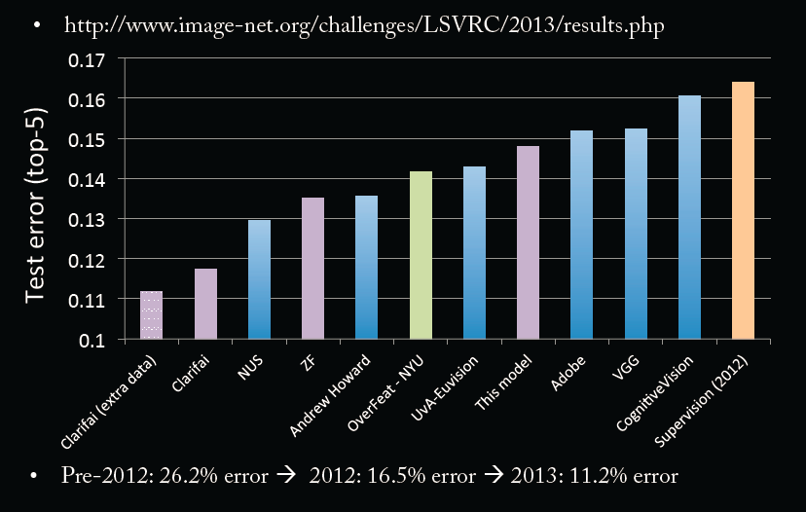
Imagenet Classifications 2013

Slide 55
Conv Net Topology
5 convolutional layers
3 fully connected layers + soft-max
650K neurons , 60 Mln weights

Slide 56
Why ConvNet should be Deep?
Rob Fergus, NIPS 2013

Slide 57
Why ConvNet should be Deep?

Slide 58
Why ConvNet should be Deep?

Slide 59
Why ConvNet should be Deep?

Slide 60
Why ConvNet should be Deep?

Slide 61
Conv Nets: beyond Visual Classification

Slide 62

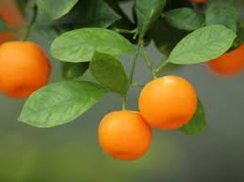
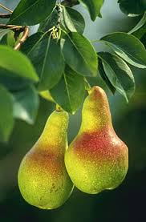
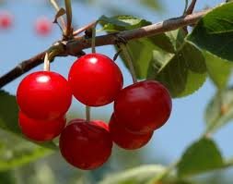
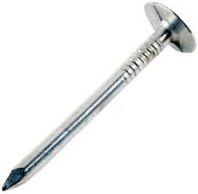
CNN applications
CNN is a big hammer
Plenty low hanging fruits
You need just a right nail!

Slide 63
Conv NN: Detection
Sermanet, CVPR 2014

Slide 64
Conv NN: Scene parsing
Farabet, PAMI 2013

Slide 65
CNN: indoor semantic labeling RGBD
Farabet, 2013

Slide 66
Conv NN: Action Detection
Taylor, ECCV 2010

Slide 67
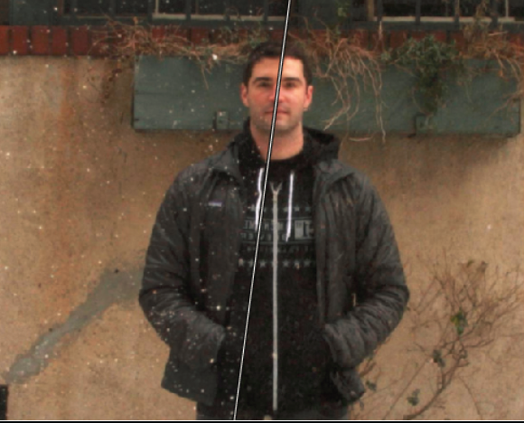
Conv NN: Image Processing
Eigen , ICCV 2010

